Slide 1
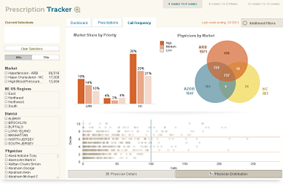
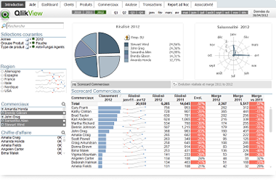
Thermal Curing
Proposed Digital Dashboard

Slide 2
Thermal Curing Digital Dashboard
Requirements

Slide 3
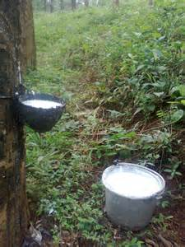
Background
Historically, rubber has been an important produce for Malaysia
Although overtaken by palm oil, rubber has made a comeback as an important crop due to rising output prices, driven by steep oil prices and other factors
Rubber production is not achieved on an optimal basis due to a number of constraints
Ageing trees, duration of maturing process, cost of fertilizers, etc are factors that inhibit optimal production of rubber
A fast-track solution that can increase the productivity of rubber trees and revive ageing ones can lead towards optimal production of rubber products, allowing the nation to benefit from high rubber prices

Slide 4
A Solution - Thermal Curing
Thermal Curing refers to a production process and recipe to produce nutrients for trees
The nutrients so produced are significantly more effective than traditional fertilizers
They are also more cost effective
Presently, several agencies are interested to conduct field tests on the application of these nutrients
To prove the effectiveness of the nutrients, Thermal Curing wishes to setup a web-based digital dashboard that shows the
Application of the nutrients
Results achieved
Environmental factors

Slide 5
Objective
To install, develop and configure a web-based digital dashboard system for Thermal Curing, showing and enabling analysis of
Application of nutrients
Schedule of application
Quantity applied
Results achieved
Rubber production
Micro-factors eg viscosity, rate of output, quality
Environmental Factors
Weather patterns
Tapping and field maintenance practices
Land and field conditions

Slide 6
Thermal Curing Digital Dashboard
Proposed Solution

Slide 7
Modules
Historical Analysis
Showing application of nutrients, results achieved against control groups, environmental factors
What-if analysis
Extrapolation of results, forecasted Returns on Investments, etc
These modules are to be developed separately from one another due to technical and time constraints
However, integration of these modules may be a consideration for future enhancement
The integration of data and the execution of the associated integration processes during an interactive presentation via the web is a critical factor affecting feasibility

Slide 8
Historical Analysis
This module is to enable display and analysis of historical data showing
Identification of fields and trees – test groups and control groups, age of trees, clone types, relevant historic parameters etc
Application of nutrients – types of nutrients, quantity, frequency, consistency, etc
Results obtained – output produced, rate of flow, viscosity and other quality parameters, etc
Environmental factors – weather conditions, land and other field conditions, tapping practices, planting and maintenance practices, application of other fertilizers and chemicals including stimulants, etc

Slide 9
What-If Analysis
Provides a web-based platform to perform what-if simulations on the following factors
Nutrients – planned consumption quantity and costs
Fertilizers and other chemicals – cost of alternatives
Production – forecasted production and prices
Return on Investments – rate of return, payback period, break-even analysis

Slide 10
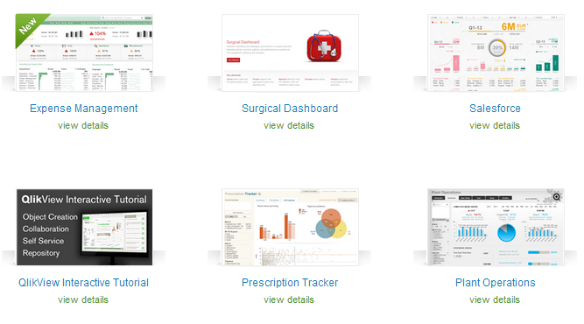
Suggested Dashboard Solution
Qlikview

Slide 11
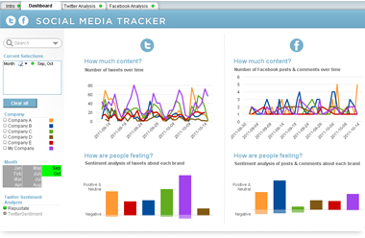
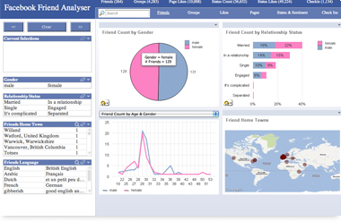
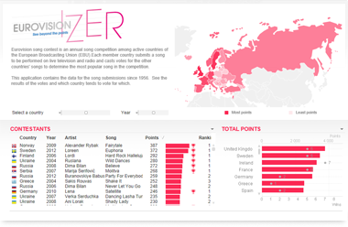
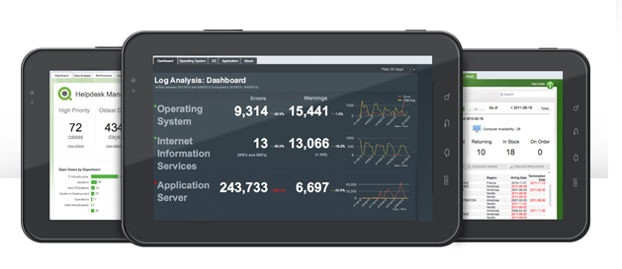
QlikView

Slide 12
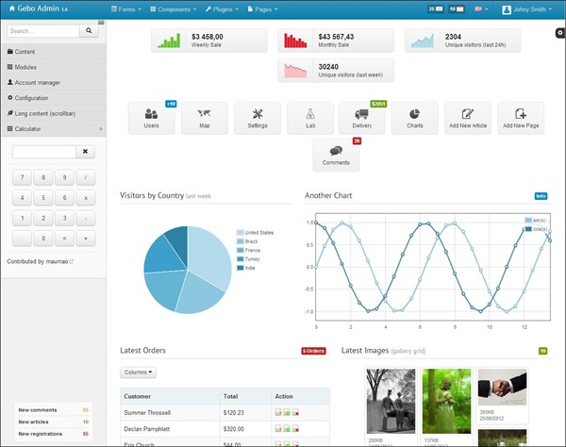
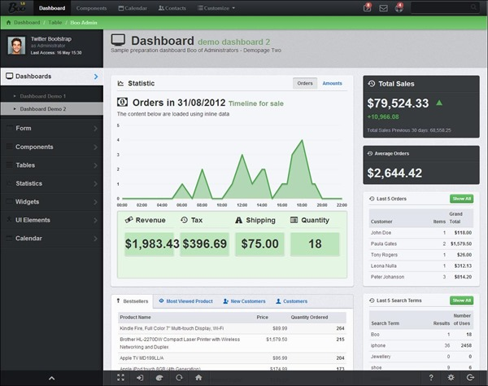
Suggested What-If Analysis Solution
Bootstrap Template
Bootstrap templates do not provide powerful and flexible analysis like Qlikview
However, bootstrap templates permit building of interactive what-if simulation which Qlikview does not provide

Slide 13
Solution Architecture
These web-based solutions require
A shared, combined database and web server with a fixed IP address
Our recommendations
A Windows-based server – easier to maintain
With
IIS Web Server
PHP Language
MySQL Database
At least one Dual Core CPU
8GB RAM
500GB Hard Disk
Internet and Networking Capabilities
At least a software anti-virus, firewall and internet security package

Slide 14
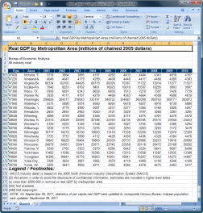
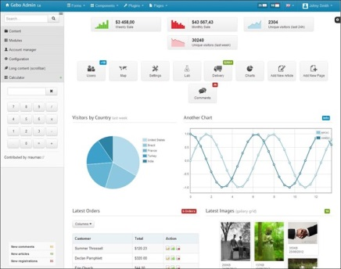
Solution Architecture
Database cum Web Server
Microsoft Excel CSV File
QlikView Dashboard
Internet
Data Extraction and Transformation Logic
Data Import Applica-tion
MySQL Database
Data Storage Logic
BootStrap Dashboard

Slide 15
Assumptions That Our Recommendation Are Based On
Number of Concurrent Users – maximum 3 persons
Number of pre-identified named users – maximum 3 persons
Number of Total Transactions (historical records) – maximum 100 per day
Running only the 2 abovementioned modules

Slide 16
Solution Components
Hardware – inclusive of setup and installation
Software – Operating system, database, php, web server inclusive of installation, configuration and security setup
Networking – Including setup of Domain Name, DNS, fixed IP, configuration of firewall and antivirus, troubleshooting and fine tuning
Solution
Historical Analysis – development, testing and deployment of
Data Import Features
Historical Database
In Memory Analytical Mechanism (of Qlikview) with Dashboards
What If Analysis
Parameter entry and results calculations
Presentation dashboards
Data saving features
Database for saved data

Slide 17
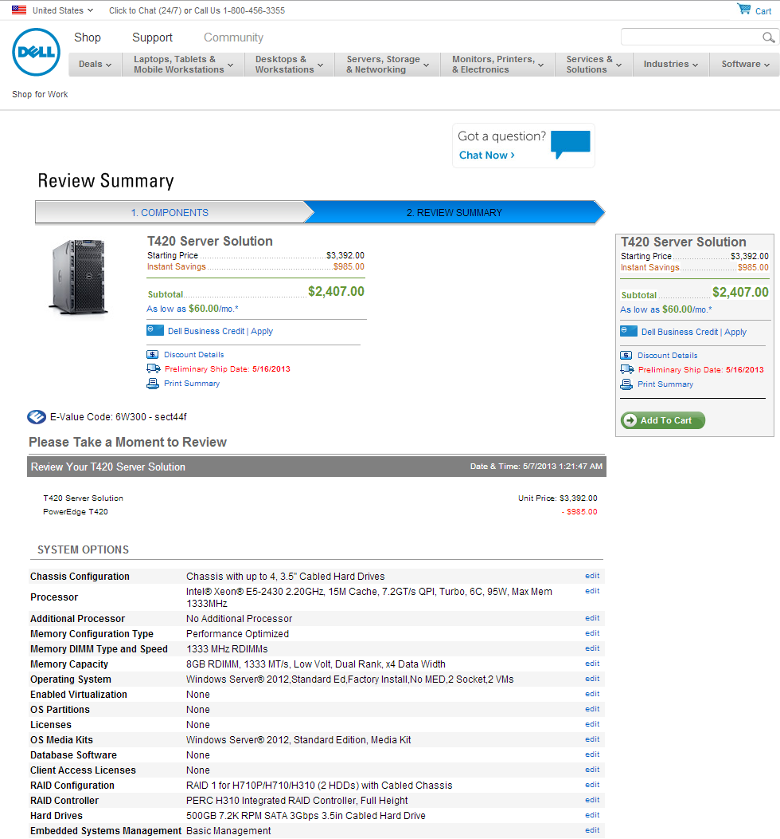
Hardware
There are many server models that can meet the requirements of the system
Here is one recommended server model, recommended based on their reliable Next Business Day support for problems

Slide 18
Networking Components
Thermal Curing need to obtain the following components to provide internet access to the server
An internet provider package with a fixed IP line
It also recommended that Thermal Curing obtain the following networking software
A server edition of Internet Security package with the following minimal modules
Anti-Virus
Firewall

Slide 19
Software
Operating System – Windows Server 2012 Standard Edition – can be purchased in an OEM package with the Server
PHP and MySQL – free licenses, can be downloaded from their respective websites
QlikView digital dashboard – need to be purchased from QlikView
Suggested minimum 3 named user licenses
1 for Thermal Curing
1 for Plantation Head Office (eg General Manager)
1 for Plantation Site Office (eg Plantation Manager)
Please bear in mind that each named user license allows only 1 pre-defined user to use the system. It is not the same as concurrent user licenses. If need be, additional named user licenses need to be purchased to allow more users. Concurrent users are also available, but each concurrent user license cost about 4 times a named user license.
Bootstrap Template license – need to be purchased online from the relevant vendor depending on which Template is chosen

Slide 20
Hardware/Software Installation and Networking Services
Thermal Curing need to appoint a vendor with the necessary skills to install the following items
Server Hardware
Operating System
Networking Software
Web Server (IIS built in with Windows)
PHP and MySQL
QlikView
Bootstrap Template
Other related security, OS and networking configuration
The Terms of Reference for the vendor should include
Commissioning and Testing that all the abovementioned components are working and accessible from the Internet
Maintenance Contract or Arrangement in case corrective actions are required for breakdowns and other problems

Slide 21
Solution Development – Historical Analysis
We shall provide the solution design and development services consisting of the following
Design and development of database running on MySQL for storing
Historical Analysis data
QlikView digital dashboard
Documentation of user requirements
A maximum of 6 pages of digital dashboards running on QlikView with the associated logic and programming based on a signed-off user requirements
An application to read data from a Microsoft Excel CSV file format into the MySQL database
Data extraction, transformation and loading logic to read data from the database into QlikView

Slide 22
Solution Development – What-If Analysis
We shall provide the solution design and development services consisting of the following
Documentation of user requirements defining the set of parameters to be used in the what-if analysis, the desired results to be calculated, and the calculation formulas
Design and development of additional components in the MySQL database to store what-if analysis data
Design and development of a web-based dashboard providing interactive what-if analysis
Integration of the Historical Analysis dashboard (QlikView) with the What-If Analysis (BootStrap Templates) dashboard present a technical feasibility challenge for which we do not which to commit any solution at this time
The Historical Analysis dashboard (QlikView) provide strong analytical capabilities (eg drilldowns, slice-and-dice, etc) but not support for interactive what-if analysis
The What-If Analysis dashboard provide interactive simulation capabilities without strong analysis capabilities
Other products that combine both capabilities may not provide reasonable ROI for investment in (costing > RM500,000 in software licenses)

Slide 23
Thermal Curing Digital Dashboard
Acquisition and Costing Process

Slide 24
Acquisition
Thermal Curing need to procure the following components by dealing directly with appropriate vendors
Server hardware – eg Dell, HP, or other vendors
Networking components – eg Norton Anti-Virus or others
Software
Windows Server
PHP, MySQL
QlikView
Bootstrap Template
Hardware/ networking installation services

Slide 25
Development Timeframe– Historical Analysis
Activities | Week 1 | Week 2 | Week 3 | Week 4
Documentation of User Requirements
Database Design and Development
Data Extraction Design and Development
Dashboard Design and Development
Testing and Commissioning

Slide 26
Development Timeframe– What-If Analysis
Activities | Week 1 | Week 2 | Week 3 | Week 4
Documentation of User Requirements
Database Design and Development
Data Entry and Simulation - Design and Development
Dashboard Design and Development
Testing and Commissioning

Slide 27
Work Concurrency
To compress the overall timeline, design and development of the dashboards should take place concurrently while the servers are being delivered and setup
The design and development of the dashboards can commence upon confirmation of the targeted platforms to be used
PHP and MySQL for back-end processing
QlikView for Historical Analysis
Bootstrap for What-If Analysis
Typically, the process of ordering, delivery and installation of hardware and network will take 2-4 weeks. In particular, the following services normally need to be expedited
Hardware delivery 1-2 weeks
Fixed IP Internet connection 2-4 weeks

Slide 28
Estimated Costing – Historical Dashboard
Total estimated man hours = 60 man hours spread over 4 calendar weeks of development
Charges per man hour = RM80
Total cost for Design and Development of Historical Analysis Dashboard = 60 hours x RM80 = RM4,800
Terms of Payment
Upon engagement and commencement of work RM2,400
Upon commissioning and testing RM2,400
Any additional enhancement work that may later on be required will be charged at RM80 per man hour

Slide 29
Estimated Costing – What-If Dashboard Dashboard
Total estimated man hours = 48 man hours spread over 3 calendar weeks of development
Charges per man hour = RM80
Total cost for Design and Development of Historical Analysis Dashboard = 48 hours x RM80 = RM3,840
Terms of Payment
Upon engagement and commencement of work RM1,900
Upon commissioning and testing RM1,940
Any additional enhancement work that may later on be required will be charged at RM80 per man hour

Slide 30
Estimated Costs of All Components
Thermal Curing need to liase directly with the relevant vendors to purchase/ acquire the items that we do not provide. These estimates are given for guidance only
Items | RM
Server Hardware + Operating System + Internet Security | 10,000
MySQL Database + PHP + IIS Web Server | F.O.C
QlikView (3 named user licenses) | 20,000
Bootstrap Template | 300
Hardware & Network Installation | 3,000
Design and Development of Dashboards – Historical* | 4,800*
Design and Development of Dashboards – What-If Simulation* | 3,840*
Total Estimated Cost (of which we only provide and charge for items marked *) | 41,940

Slide 31
Thank You

